Slide 1

Paper ID : 167
De Authentication Attack: A Review
Tushar Rakhra¹, Arjit Kaushal², Sarvesh Tanwar^{*3}, Priyanka Datta⁴, Ajay Rana⁵

Slide 2
De Authentication Attack: A Review
outline
Introduction
Motivation & Objectives
Effects of hacking
Application of de-authentication attack
DE-Authentication attack in practice
Some research on global cyber security
Conclusion and future work

Slide 3
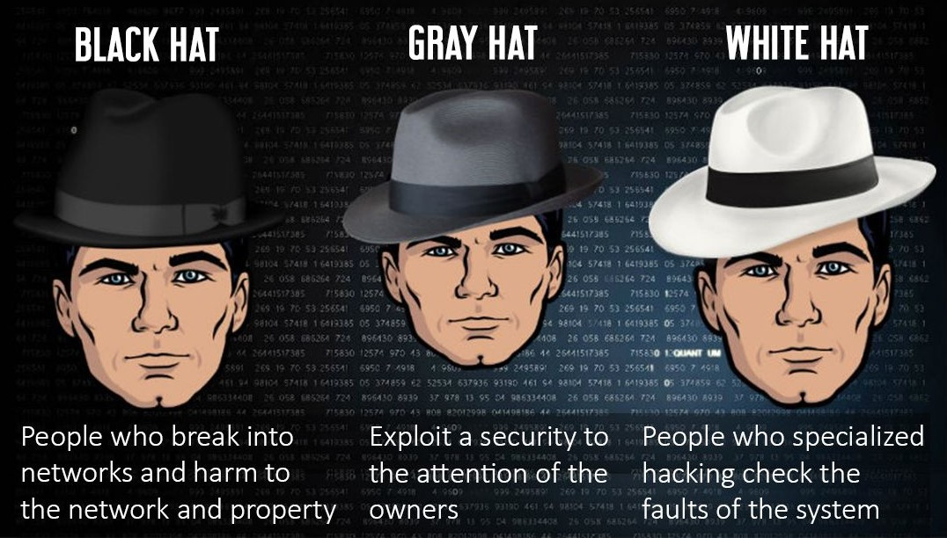
Introduction
Most of the work in today’s day to day life is done online. Myriad people these days have their private or sensitive data online.
Almost every companies and big domains have sensitive and confidential data, which are available online.
This approach of people depending so much on network and internet, it has given hackers a new boon. Three types:-

Slide 4
Motivation and Ojectives
Motivation
This is the prime reason to write this paper to tell about the loss incurred due to de authentication and ethical hacking by these giant’s firms and also tell about importance of ethical hacking and ethical hackers in such a world where no data is safe.
Objectives
This paper aims to spread awareness about ethical hacking and how it affects people. In recent years’ technology has proved to be a boon with some bane’s too. We can’t rely too much on security as we come to know through this paper that security can be compromised easily. This paper shows how much security breaches occur throughout different devices and also through different types of organizations.

Slide 5






Effects of Hacking
Top cyberattacks which ruined many companies
2.9mil accounts stolen leading to loss of all personal data
77mil User data and banking information compromised
110mil customers lost their personal data leading to $18mil loss.
3bil user accounts information leaked
1.2bil login and passwords Hacked.

Slide 6
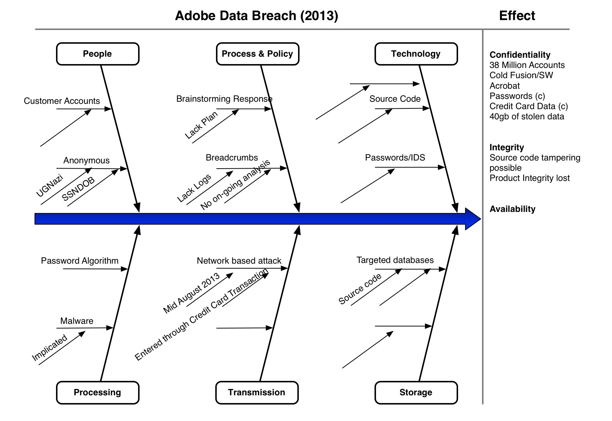
Explaining one of the attacks in brief

Slide 7
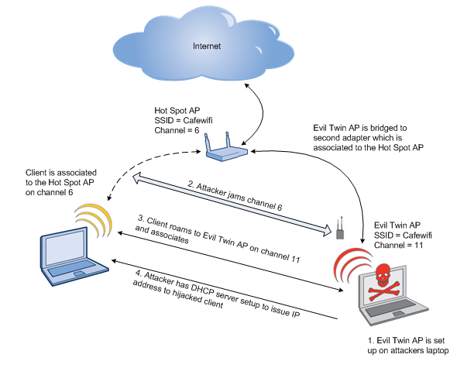
Application of de-authentication attack
1. Evil twin access points
De-authentication attacks are mainly used to disconnect the client from the main access point, so that to force them to connect to an evil twin access point. By this way the hackers can capture the packets transferred between the client and the access point

Slide 8
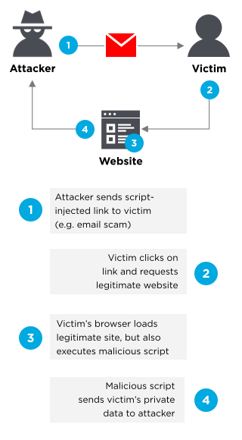
2. Password attacks
To initialize a brute force or dictionary attack on a client connected to an Wi-Fi with WPA or WPA2 enabled, a hacker has to capture a WPA 4 way handshake. The user can be forced to connect again and provide a 4-way handshake.

